Slide 1
Collaborative filtering
CS616

Slide 2
Collaborative Filtering (CF)
The most prominent approach to generate recommendations
used by large, commercial e-commerce sites
well-understood, various algorithms and variations exist
applicable in many domains (book, movies, DVDs, ..)
Approach
use the "wisdom of the crowd" to recommend items
Basic assumption and idea
Users give ratings to catalog items (implicitly or explicitly)
Customers who had similar tastes in the past, will have similar tastes in the future

Slide 3
User-based nearest-neighbor collaborative filtering
The basic technique:
Given an "active user" (Alice) and an item I not yet seen by Alice
The goal is to estimate Alice's rating for this item, e.g., by
find a set of users (peers) who liked the same items as Alice in the past and who have rated item I
use, e.g. the average of their ratings to predict, if Alice will like item I
do this for all items Alice has not seen and recommend the best-rated
 | Item1 | Item2 | Item3 | Item4 | Item5
Alice | 5 | 3 | 4 | 4 | ?
User1 | 3 | 1 | 2 | 3 | 3
User2 | 4 | 3 | 4 | 3 | 5
User3 | 3 | 3 | 1 | 5 | 4
User4 | 1 | 5 | 5 | 2 | 1

Slide 4
User-based nearest-neighbor collaborative filtering
Some first questions
How do we measure similarity?
How many neighbors should we consider?
How do we generate a prediction from the neighbors' ratings?

Slide 5


Measuring user similarity
A popular similarity measure in user-based CF: Pearson correlation
a, b : users
r_{a,p} : rating of user a for item p
P : set of items, rated both by a and b
Possible similarity values between -1 and 1; = user's average ratings
$\overline{r_{a}}$, $\overline{r_{b}}$

Slide 6
Pearson correlation
Takes differences in rating behavior into account
Works well in usual domains, compared with alternative measures
such as cosine similarity

Slide 7
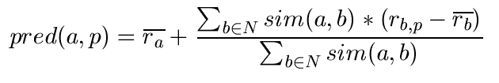
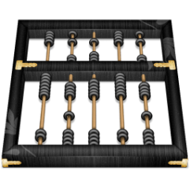
Making predictions
A common prediction function:
Calculate, whether the neighbors' ratings for the unseen item i are higher or lower than their average
Combine the rating differences – use the similarity as a weight
Add/subtract the neighbors' bias from the active user's average and use this as a prediction

Slide 8
Making recommendations
Making predictions is typically not the ultimate goal
Usual approach (in academia)
Rank items based on their predicted ratings
However
This might lead to the inclusion of (only) niche items
In practice also: Take item popularity into account
Approaches
"Learning to rank"
Optimize according to a given rank evaluation metric (see later)

Slide 9
Improving the metrics / prediction function
Not all neighbor ratings might be equally "valuable"
Agreement on commonly liked items is not so informative as agreement on controversial items
Possible solution: Give more weight to items that have a higher variance
Value of number of co-rated items
Use "significance weighting", by e.g., linearly reducing the weight when the number of co-rated items is low
Case amplification
Intuition: Give more weight to "very similar" neighbors, i.e., where the similarity value is close to 1.
Neighborhood selection
Use similarity threshold or fixed number of neighbors

Slide 10
Item-based CF
Scalability issues arise with U2U if many more users than items (m >> n , m = |users|, n = |items|)
e.g. Amazon.com
Space complexity O(m²) when pre-computed
Time complexity for computing Pearson O(m²n)
High sparsity leads to few common ratings between two users
Basic idea: "Item-based CF exploits relationships between items first, instead of relationships between users"

Slide 11
Item-based collaborative filtering
Basic idea:
Use the similarity between items (and not users) to make predictions
Treat ratings as item features (big assumption)
Example:
Look for items that are similar to Item5
Take Alice's ratings for these items to predict the rating for Item5
 | Item1 | Item2 | Item3 | Item4 | Item5
Alice | 5 | 3 | 4 | 4 | ?
User1 | 3 | 1 | 2 | 3 | 3
User2 | 4 | 3 | 4 | 3 | 5
User3 | 3 | 3 | 1 | 5 | 4
User4 | 1 | 5 | 5 | 2 | 1

Slide 12


The cosine similarity measure
Produces better results in item-to-item filtering
for some datasets, no consistent picture in literature
Ratings are seen as vector in n-dimensional space
Similarity is calculated based on the angle between the vectors
Adjusted cosine similarity
take average user ratings into account, transform the original ratings
U: set of users who have rated both items a and b

Slide 13
Pre-processing for item-based filtering
Item-based filtering does not solve the scalability problem itself
Pre-processing approach by Amazon.com (in 2003)
Calculate all pair-wise item similarities in advance
The neighborhood to be used at run-time is typically rather small, because only items are taken into account which the user has rated
Item similarities are supposed to be more stable than user similarities
Memory requirements
Up to N² pair-wise similarities to be memorized (N = number of items) in theory
In practice, this is significantly lower (items with no co-ratings)
Further reductions possible
Minimum threshold for co-ratings (items, which are rated at least by n users)
Limit the size of the neighborhood (might affect recommendation accuracy)

Slide 14
More about ratings
Pure CF-based systems only rely on the rating matrix
Explicit ratings
Most commonly used (1 to 5, 1 to 7 Likert response scales)
Research topics
"Optimal" granularity of scale; indication that 10-point scale is better accepted in movie domain
Multidimensional ratings (multiple ratings per movie)
Challenge
Users not always willing to rate many items; sparse rating matrices
How to stimulate users to rate more items?
Implicit ratings
clicks, page views, time spent on some page, demo downloads …
Can be used in addition to explicit ones; question of correctness of interpretation

Slide 15
Data sparsity problems
Cold start problem
How to recommend new items? What to recommend to new users?
Straightforward approaches
Ask/force users to rate a set of items
Use another method (e.g., content-based, demographic or simply non-personalized) in the initial phase
Alternatives
Use better algorithms (beyond nearest-neighbor approaches)
Example:
In nearest-neighbor approaches, the set of sufficiently similar neighbors might be to small to make good predictions
Assume "transitivity" of neighborhoods

Slide 16
Example algorithms for sparse datasets
Recursive CF
Assume there is a very close neighbor n of u who however has not rated the target item i yet.
Idea:
Apply CF-method recursively and predict a rating for item i for the neighbor
Use this predicted rating instead of the rating of a more distant direct neighbor

Slide 17
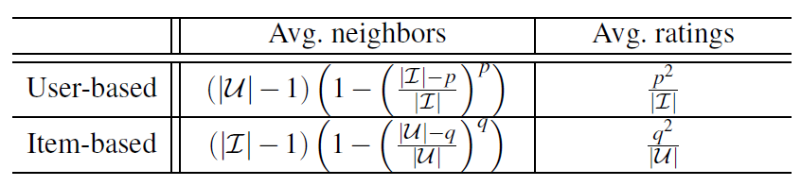
Contrast – u2u vs i2i
p = avg number of ratings per user
q = avg number of ratings per item

Slide 18
Contrast – u2u vs i2i
 | U2U | I2I
Accuracy | |U|<<|I| | |U|>>|I|
Efficiency | |U|<<|I| | |U|>>|I|
Stability | Static users | Static items
Justifiability |  | Always better
Serendipity | Always better
Shared problems: coverage, sparsity

Slide 19
Memory-based vs model-based approaches
Both u2u and i2i CF are "memory-based"
the rating matrix is directly used to find neighbors / make predictions
does not scale for most real-world scenarios
large e-commerce sites have tens of millions of customers and millions of items
Model-based approaches
based on an offline pre-processing or "model-learning" phase
at run-time, only the learned model is used to make predictions
models are updated / re-trained periodically
large variety of techniques used
model-building and updating can be computationally expensive

Slide 20
Model-based approaches
Plethora of different techniques proposed in the last years, e.g.,
Matrix factorization techniques, statistics
singular value decomposition, principal component analysis
Association rule mining
compare: shopping basket analysis
Probabilistic models
clustering models, Bayesian networks, probabilistic Latent Semantic Analysis
Various other machine learning approaches
Costs of pre-processing
Usually not discussed
Incremental updates possible?

Slide 21
CFs using matrix factorization
Basic idea: Trade more complex offline model building for faster online prediction generation
Singular Value Decomposition for dimensionality reduction of rating matrices
Captures important factors/aspects and their weights in the data
factors can be genre, actors but also non-understandable ones
Assumption that k dimensions capture the signals and filter out noise (K = 20 to 100)
Constant time to make recommendations
Approach also popular in IR (Latent Semantic Indexing), data compression, …

Slide 22
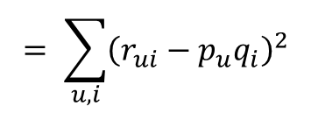
SVD: basic intuition
I items
k factors
I items
U users
k factors
U users
Q
P
R
Minimize err(k) = |R – PQ|² _{F}
$$= \sum_{u,i}{{\left(r_{ui}−p_{u}q_{i}\right)}^{2}}$$
Equivalent to SVD

Slide 23
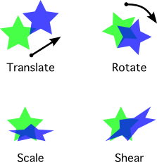
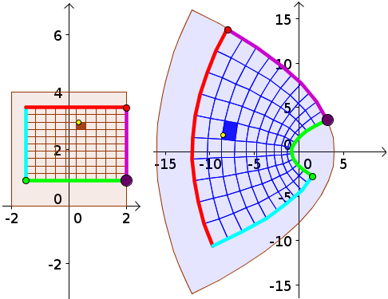
Linear transformations
F(u + v) = F(u) +F(v)
F(cu) = cF(u)

Slide 24

Matrices represent linear transforms
A linear map Rn → Rm is equivalent to an n-by-m matrix
What does this matrix do?
It transforms the unit square
Transformation clarifies the role of matrices as linear maps

Slide 25


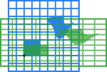

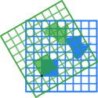
Matrices as instruction lists

Slide 26
Eigenvalues and eigenvectors
Eigenvalue definition Ax = λx
Calculation: solutions of |A - λI| = 0
Apply solutions to original equation to calculate eigenvectors (A- λI)v = 0
Set of eigenvectors, along with the null set, forms the eigenbasis of a matrix
What does it mean?
Special simplified instruction set that is equivalent to the original instruction set
but implemented using only scaling

Slide 27
Eigendecomposition
Writing out the transformation operation using its basic components
A = ELE⁻¹
E is a matrix with each column an eigenvector
L is a diagonal matrix, with each non-zero element an eigenvalue
Can arrange this in decreasing order of eigenvalue magnitude
What happens when we set the smaller eigenvalues to zero?

Slide 28
Latent factor models via matrices
Factorize n x n matrix A as a product of two matrices B,C such that
B = EL^{1/2}
C^{T} = E⁻¹L^{1/2}
Can approximate A using B_{k} and C_{k} that consider only the top k eigenvalues
err(k) = |A – BC^{T}|² _{F}
Can generalize to non-square matrices
Singular value decomposition
Decompose A into UΣV^{T}
U,V are matrices of singular vectors, Σ is a diagonal matrix that contains singular values
Singular vectors of A are eigenvectors of A^{T}A and AA^{T}
Non-zero singular values of A are square roots of non-zero eigenvalues of AA^{T}

Slide 29
SVD: basic intuition
I items
k factors
I items
U users
k factors
U users
Q
P
R
Minimize err(k) = |R – PQ|² _{F}
$$= \sum_{u,i}{{\left(r_{ui}−p_{u}q_{i}\right)}^{2}}$$
Equivalent to SVD

Slide 30





Typical SVD application
SVD:
U_{k} | Dim1 | Dim2
Alice | 0.47 | -0.30
Bob | -0.44 | 0.23
Mary | 0.70 | -0.06
Sue | 0.31 | 0.93
V_{k}^{T}
Dim1 | -0.44 | -0.57 | 0.06 | 0.38 | 0.57
Dim2 | 0.58 | -0.66 | 0.26 | 0.18 | -0.36
 | Dim1 | Dim2
Dim1 | 5.63 | 0
Dim2 | 0 | 3.23
Prediction:
= 3 + 0.84 = 3.84

Slide 31
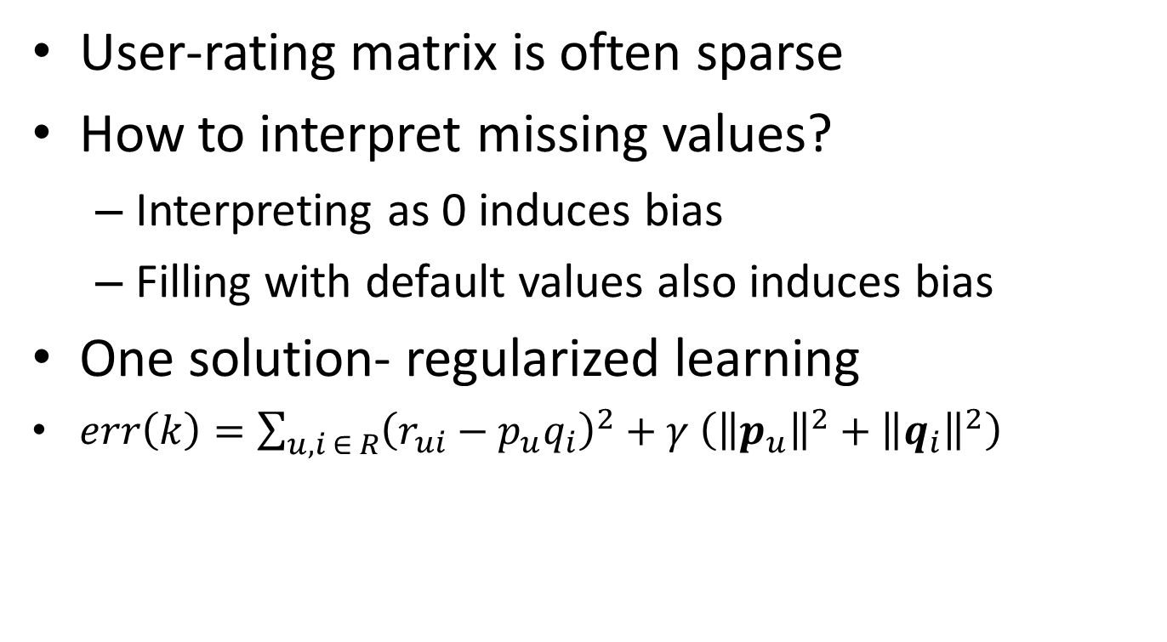
SVD concerns
User-rating matrix is often sparse
How to interpret missing values?
Interpreting as 0 induces bias
Filling with default values also induces bias
One solution- regularized learning
$err\left(k\right)=\sum_{u,i ∈ R}{{\left(r_{ui}−p_{u}q_{i}\right)}^{2}+γ \left({\left\|p_{u}\right\|}^{2}+{\left\|q_{i}\right\|}^{2}\right)}$

Slide 32


Collaborative Filtering Issues
Pros:
well-understood, works well in some domains, no knowledge engineering required
Cons:
requires user community, sparsity problems, no integration of other knowledge sources, no explanation of results
What is the best CF method?
In which situation and which domain? Inconsistent findings; always the same domains and data sets; differences between methods are often very small (1/100)
How to evaluate the prediction quality?
MAE / RMSE: What does an MAE of 0.7 actually mean?
Serendipity: Not yet fully understood
What about multi-dimensional ratings?

Slide 33
Other methods: association rule mining
Commonly used for shopping behavior analysis
aims at detection of rules such as
"If a customer purchases baby-food then he also buys diapers in 70% of the cases"
Association rule mining algorithms
can detect rules of the form X => Y (e.g., baby-food => diapers) from a set of sales transactions D = {t₁, t₂, … t_{n}}
measure of quality: support, confidence

Slide 34
Other methods: Probabilistic methods
Treat users as mixtures of topics
Treat topics as distribution over item sample frequencies
Run LDA?
What could go wrong?

